Slide 1
ROAD TO DATA SCIENCE

Slide 2
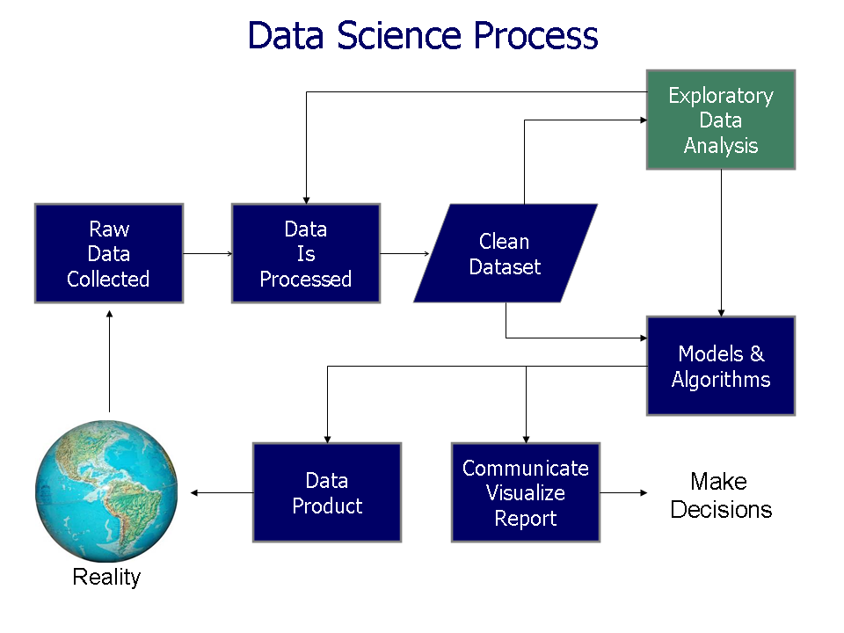

Slide 3
MODELS
REGRESSION

Slide 4
MODELS
CLUSTERING

Slide 5
MODELS
CLASSIFICATION MODEL OR LOGISTIC REGRESSION

Slide 6
DEMO IN R

Slide 7
MACHINE LEARNING

Slide 8
Machine learning is the science of getting computers to act without being explicitly programmed
Machine learning is the field of study that gives computers the ability to learn without being explicitly programmed.

Slide 9
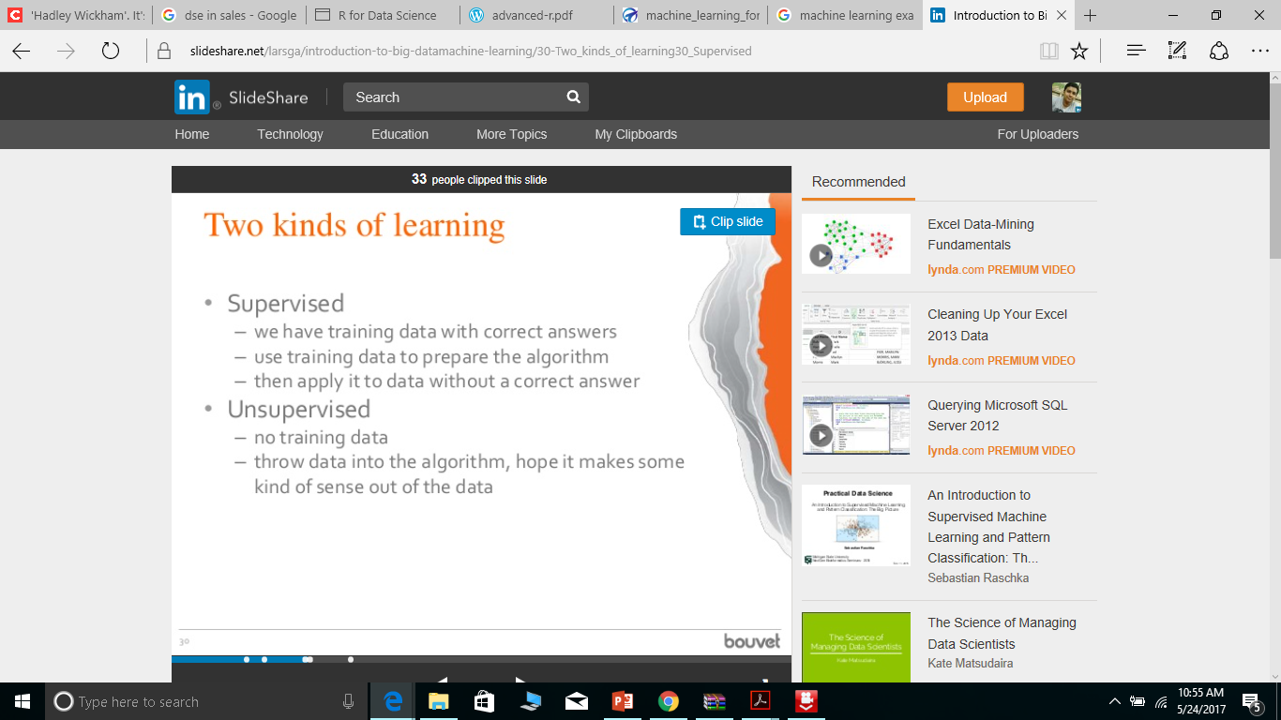
Types of Machine learning
Supervised Learning
Mail spam or not
Yes or no

Slide 10
Types of Machine learning
Unsupervised Learning
Google search
Flipkart search
All google products

Slide 11
Machine learning process
Data collection
Selecting Model
Training Model
Testing

Slide 12
DEMO IN AZURE ML STUDIO

